Slide 1
UPS ShipExec Thin Client Training for New Users

Slide 2
User Access
NCRAD will register user
Username: user’s email address
Password: NCRAD creates first default password, user can then update upon first login

Slide 3
Accessing Shipping Client
Log into the ShipExec Thin Client: https://kits.iu.edu/UPS
Click on the “Shipping” dropdown and click on “Shipping and Rating”

Slide 4
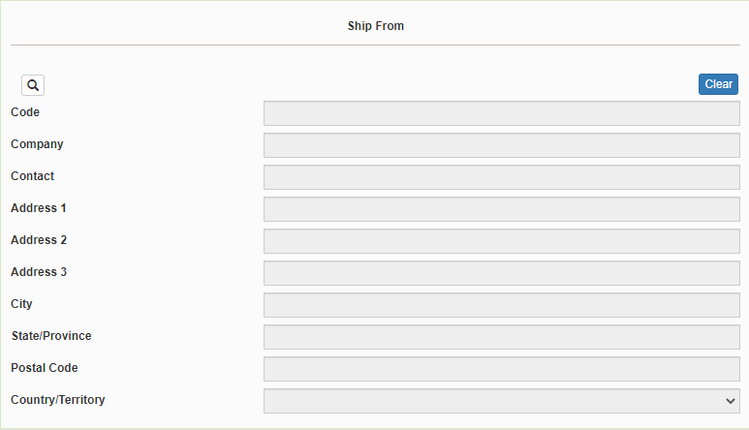
Finding Your Contact Information
On the right side of the screen, choose the name of your study from the “Study Group” drop down menu
This step must be done 1st
On the left side of the screen, Click on the magnifying glass icon

Slide 5
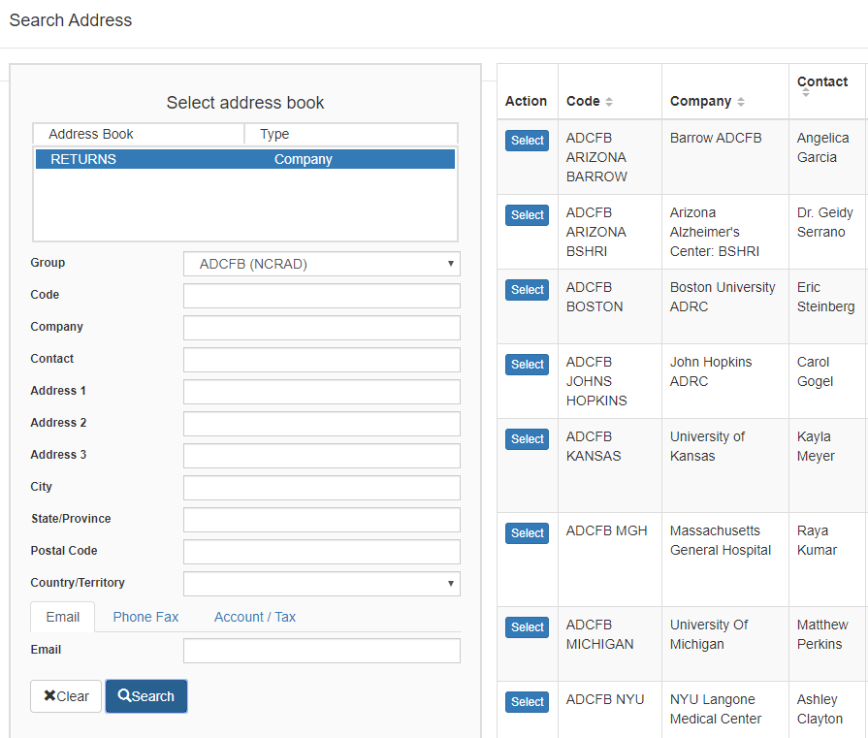
Finding Your Contact Information
On the right side of the screen, a list of all the site addresses within the study you selected should populate
User can filter the search for their address further by filling in the “Company”, “Contact”, or “Address 1” fields
Hit “Search” when ready.
Once you have found your site address, click on the “Select” button to the left of the address
If any information needs to be updated, please reach out to the NCRAD Coordinator of your study

Slide 6
Verify Information
Please verify that both the shipping information AND study reference are correct for this shipment

Slide 7
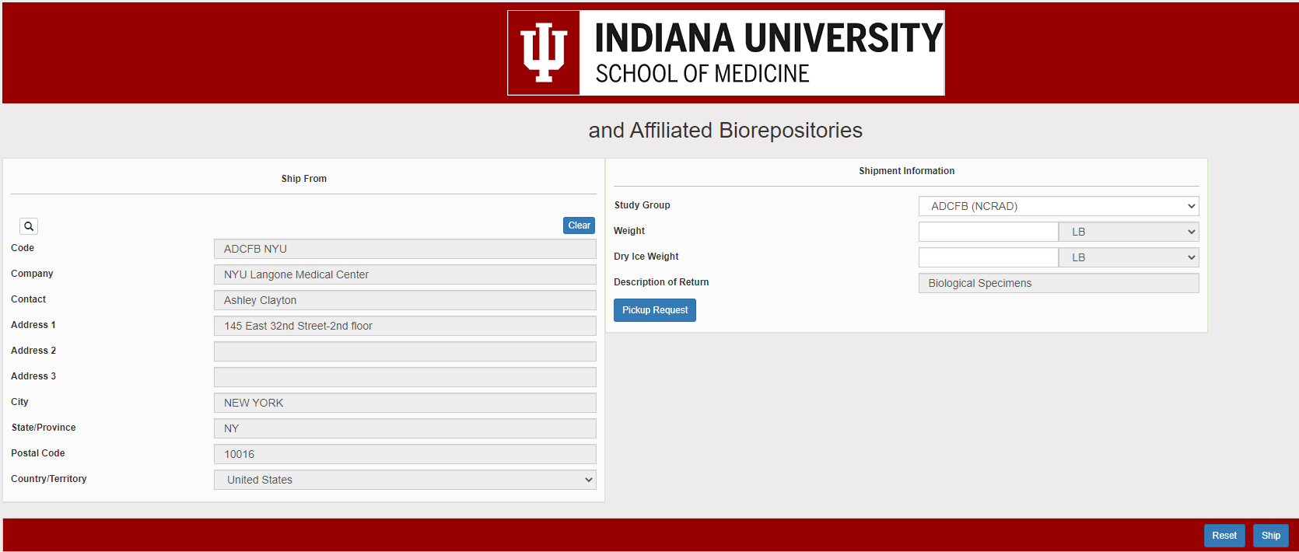
Selected wrong Contact or Study Reference?
Click Reset and repeat previous search steps

Slide 8
Entering Shipment Information
Ambient shipments
Enter the total weight of your package in the “Weight” field, leave the “Dry Ice Weight” field empty!
Frozen shipments
Enter the total weight of your package in the “Weight” field
Enter the dry ice weight in the “Dry Ice Weight” field
The “Dry Ice Weight” field cannot be higher than the “Weight” field (will receive an error message)

Slide 9
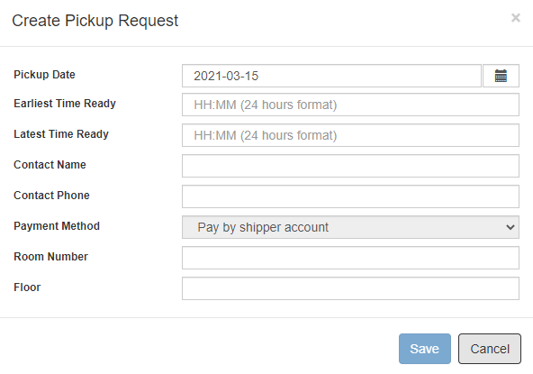
Need to request UPS Pickup?
Click on the “Pickup Request” button
Fill out all fields for the pickup request
Enter in the “Earliest Time Ready” and “Latest Time Ready” in 24-hour format
Users must schedule pickup minimum 1 hour before “Earliest Time Ready”
Choose a name and number that is the best to contact if the UPS driver has questions related to picking up your package
Entering the Room Number and Floor will help the UPS driver locate your package
Room number field is free text
Floor field is numerical only
Hit “Save” when done

Slide 10
Shipping Packages
If all fields in “Ship From” and “Shipment Information” fields are completed, and pickup request is completed (if necessary), click Ship in the bottom right corner of the page

Slide 11
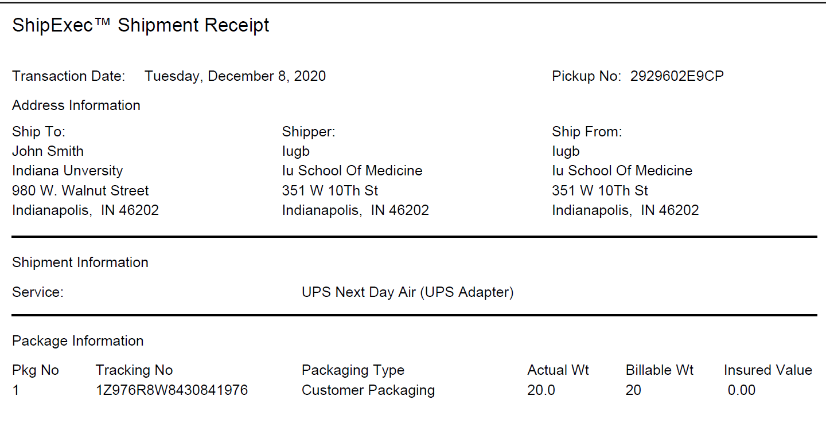
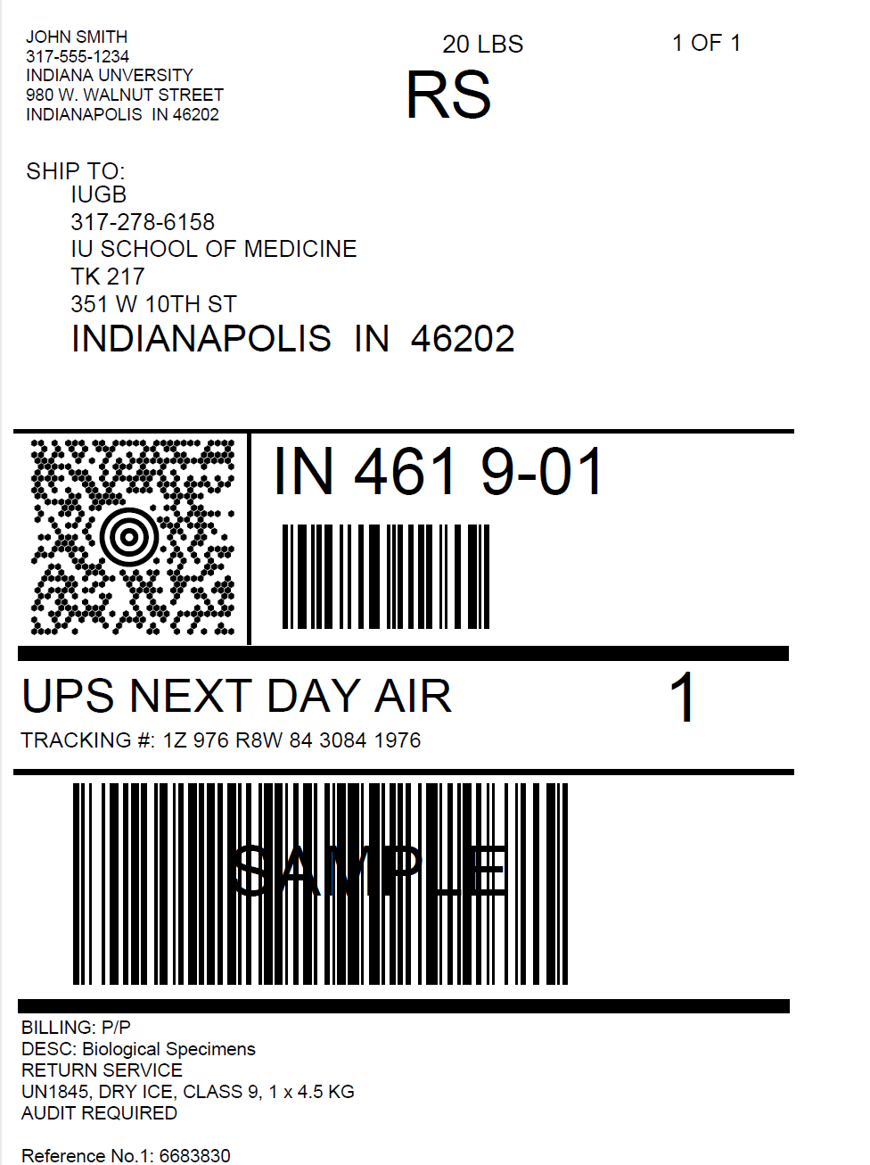
Accessing Airbill
Two PDF files will download to your computer after you click “Ship”:
Shipment Receipt
Airbill
“Pickup No.” field will populate if Pickup Request is submitted
The “Pickup No:” is the reference number to your specific pickup request in case there are any issues with your package being picked up by UPS
Check Pickup Status by going to UPS.com, click on the Shipping, select Schedule a Pickup, and look on the right side of screen to click on “Pickup Request Status”. Enter in the Pickup No. listed on receipt into PRN field and submit

Slide 12
Accessing Airbill
Print out the UPS air waybill
Fold the UPS air waybill and slide it inside the plastic UPS sleeve (NCRAD will provide these in kit requests)
Peel the back off the plastic UPS sleeve and stick the sleeve to your package, making sure it is laying as flat as possible along the surface of the package.

Slide 13
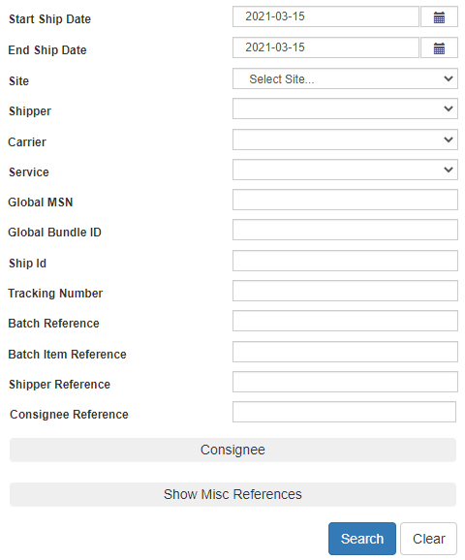
Reprint Airbills/Voiding Shipments
To reprint airbill or void a shipment, click “History” at the top of the ShipExec Thin Client portal
If your shipment doesn’t automatically pop up, enter in the date of shipment and then click “Search”

Slide 14
Reprint Airbill
Click the print icon to reprint airbill

Slide 15
Void Shipment
To void a shipment, click on the “X” symbol

